Slide 1









Whiteboardmaths.com
7
2
1
5
© 2004 All rights reserved

Slide 2

The Volume of a Cylinder
A cylinder is a prism with a circular cross-section.
πr²
h
Volume = πr²h

Slide 3
The Volume of a Cylinder
Calculate the volume of the following cylinders.
1
2
3 cm
2 m
15 m
V = πr²h = π x 2² x 15 = 188.5 m³
10 cm
3
4.2mm
V = πr²h = π x 3² x 10 = 282.7 cm³
9.2 mm
V = πr²h = π x 4.6² x 4.2 = 279.2 mm³

Slide 4


The Volume of a Cylinder
Find the capacity (in litres) of the water storage tank.
V = πr²h = π x 3.1² x 4 = 120.8 m³
100 cm
1m³
4 m
100 cm
100 cm
1 m³ =100 x 100 x100 = 1000 000 cm³ = 1 000 litres
V = 121 000 litres (3 sf)
6.2m

Slide 5
The Volume of a Cylinder
Find the capacity (in litres) of the water storage tank.
3 m
8.4m
V = πr²h = π x 4.2² x 3 = 166.3 m³
100 cm
1m³
V = 166 000 litres (3 sf)
100 cm
100 cm

Slide 6
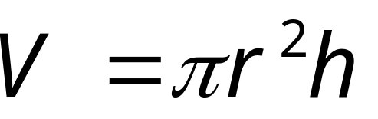
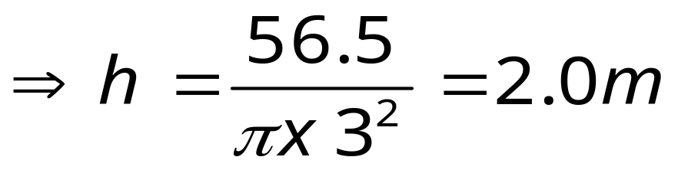
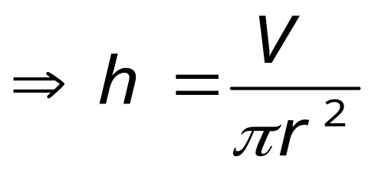
The Volume of a Cylinder
Find the height of the cylinder.
h m
Volume = 56.5 m³
6m

Slide 7
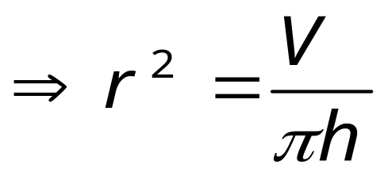
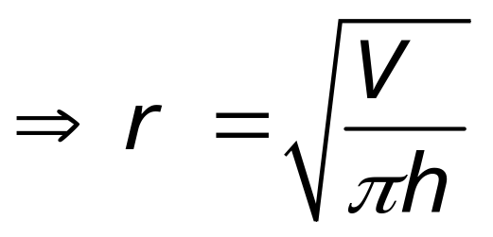

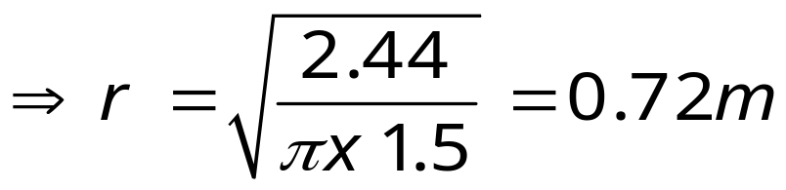
The Volume of a Cylinder
Find the radius of the cylinder.
r m
1.5m
Volume = 2.44 m³

Slide 8

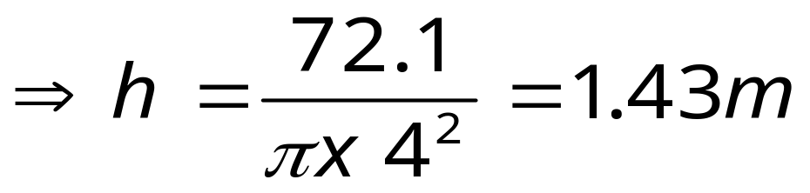
The Volume of a Cylinder
Find the height of the cylinder.
h m
Volume = 72.1 m³
8m

Slide 9

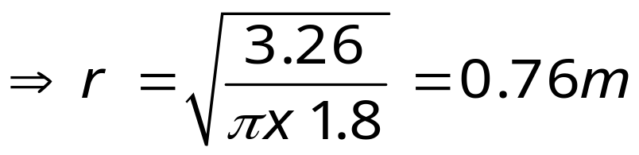
The Volume of a Cylinder
Find the radius of the cylinder.
r m
1.8m
Volume = 3.26 m³

